Slide 1
Federated Learning For Seismic Data Denoising
A Privacy-preserving Paradigm
Kamalesh Kumar Mandakolathur Guruprasad, Geetha Nair, Gayatri Sunil Ambulkar

Slide 2







01
Introduction
03
Objective
02
Federated Learning
05
Experiments
06
Metrics
04
Experimental Setup
Table of Contents
07
Results
08
Inference
sponsoring societies

Slide 3
Federated Learning For Seismic Data Denoising
A Privacy-preserving Paradigm
Kamalesh Kumar Mandakolathur Guruprasad, Indiana University Bloomington
Geetha Nair, Halliburton International Inc
Gayatri Sunil Ambulkar, Halliburton Landmark
sponsoring societies

Slide 4
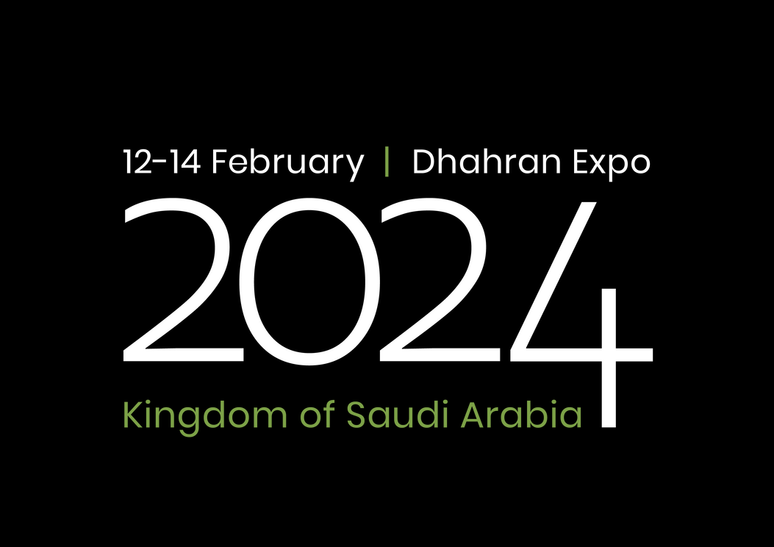

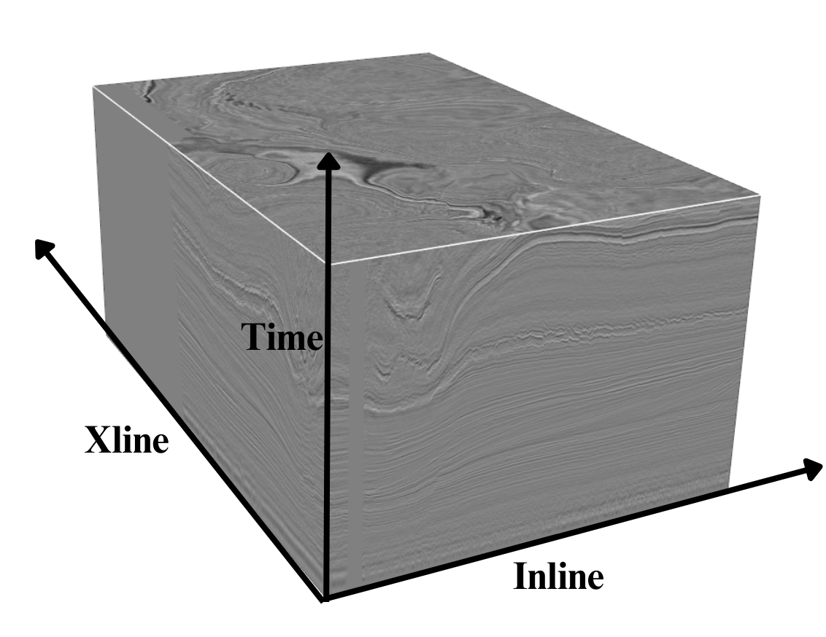
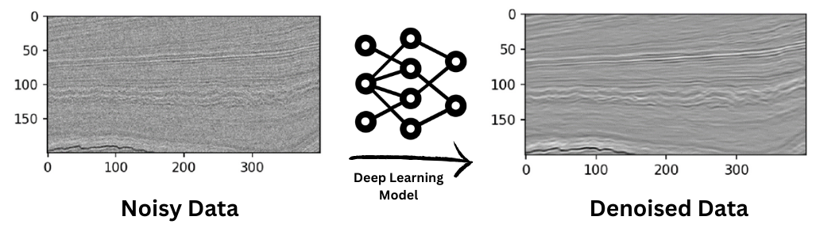
01 Introduction
About Seismic Data
Captures subsurface characteristics through reflected seismic waves
Organized in the form of a 3D cube
Valuable insights critical for shaping Field Development Plans (FDP)
What is Seismic Denoising ?
Removing noise from seismic data
Machine Learning and Deep Learning algorithms!
Paper IPTC-23888, Federated Learning For Seismic Data Denoising: Privacy-preserving Paradigm, Kamalesh Kumar Mandakolathur Guruprasad

Slide 5
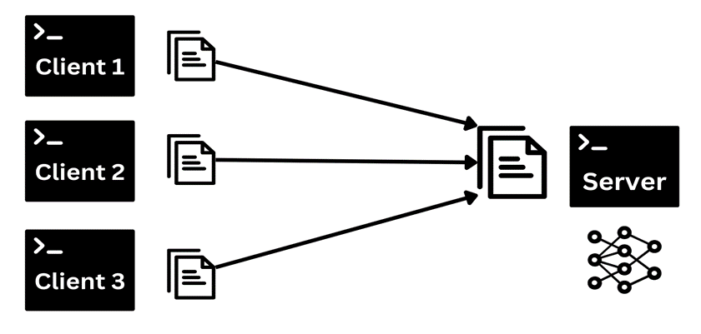
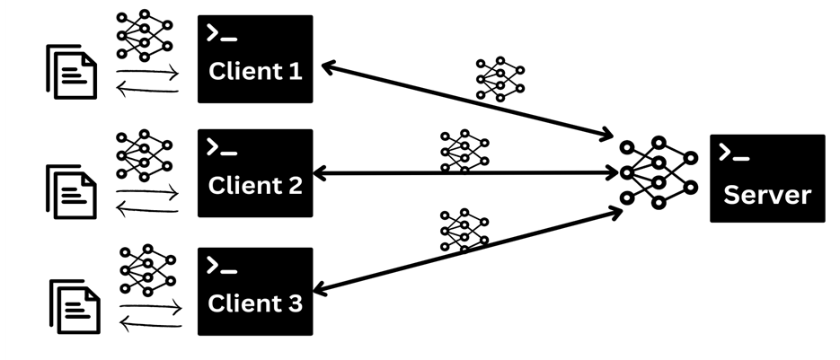
02 Federated Learning
Classical Learning
Train model on aggregated data
Data to Model
Privacy Concerns
Federated Learning
Train model on localized data
Model to Data
Privacy Preserving
Paper IPTC-23888, Federated Learning For Seismic Data Denoising: Privacy-preserving Paradigm, Kamalesh Kumar Mandakolathur Guruprasad

Slide 6
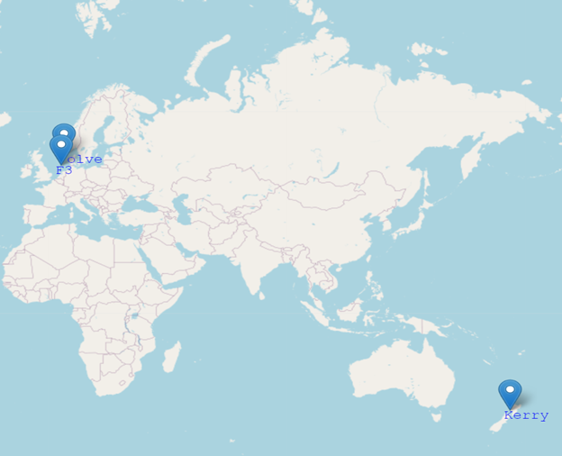
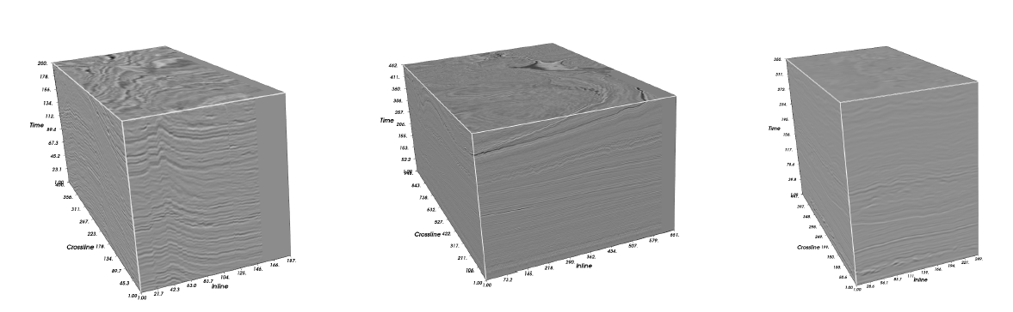
03 Objective
Setup Federated Learning framework
Data Preparation - Kerry, F3, Volve
Model architecture
Autoencoder
DnCNN
Unet
Resnet
Different Experimental Setup
Classical
Round Based
Cyclic
Performance comparison between Classical and Federated Learning approach
F3 Dutch
Kerry
Volve
Paper IPTC-23888, Federated Learning For Seismic Data Denoising: Privacy-preserving Paradigm, Kamalesh Kumar Mandakolathur Guruprasad

Slide 7
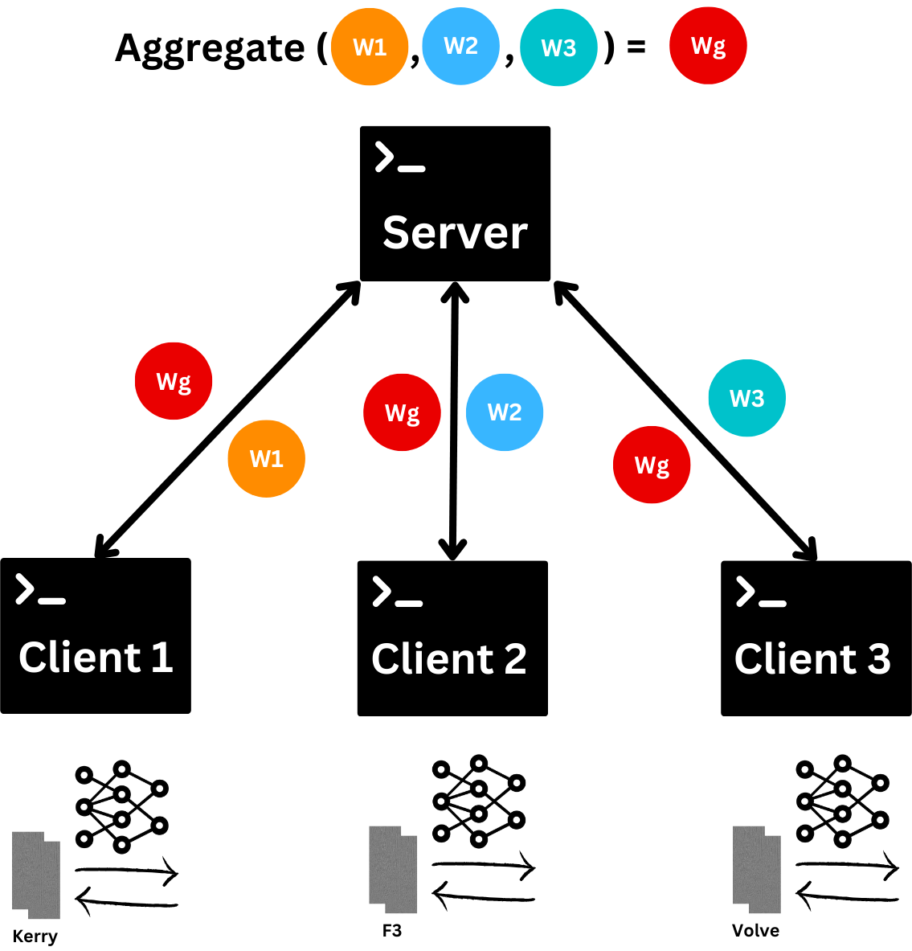
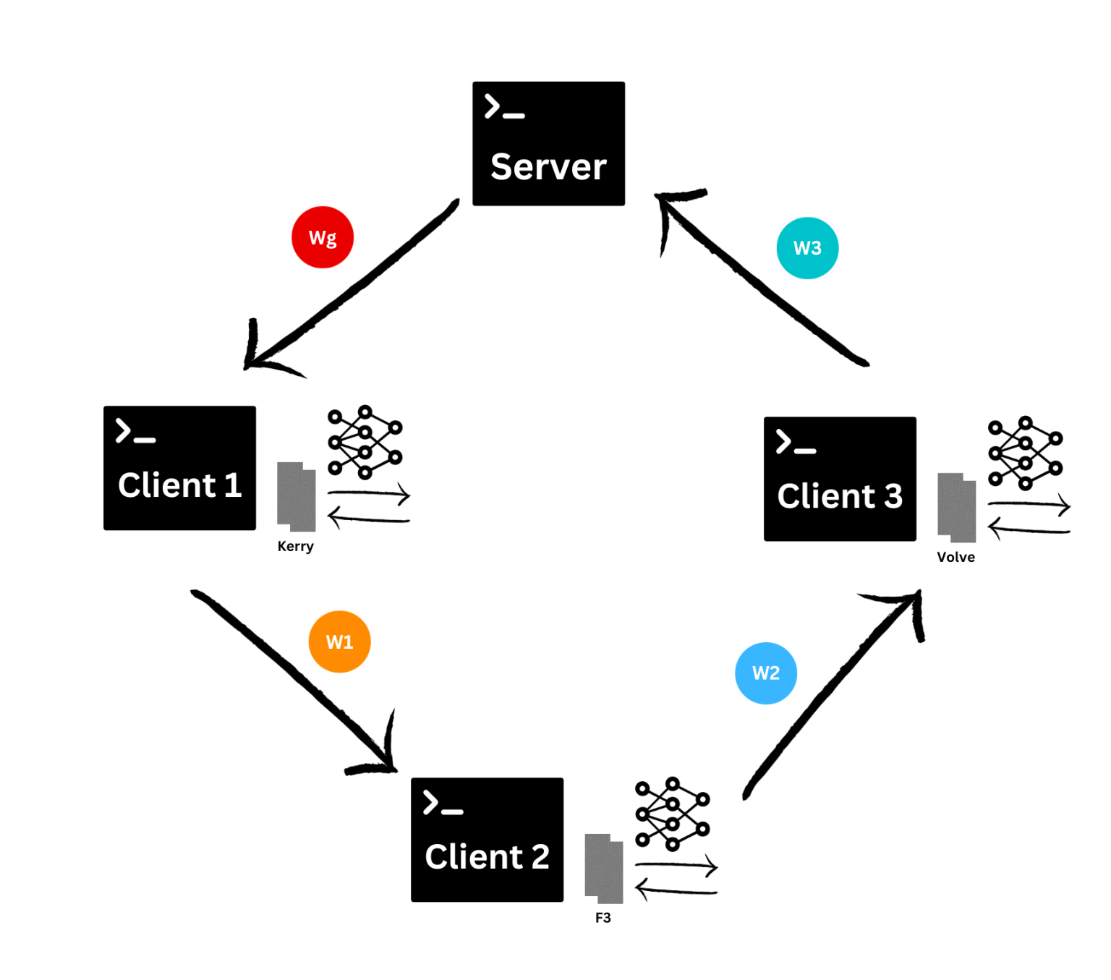
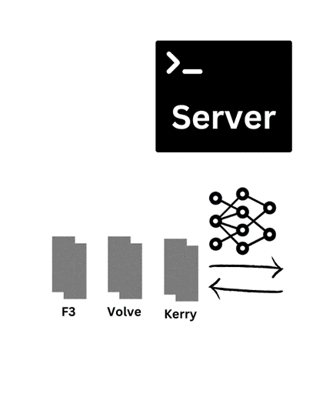
04 Experimental Setup
Classical
Round Based
Cyclic
Paper IPTC-23888, Federated Learning For Seismic Data Denoising: Privacy-preserving Paradigm, Kamalesh Kumar Mandakolathur Guruprasad

Slide 8
05 Experiments
IID
Varying position
Client 1 has the first 50 slices and client 2 has the last 50 slices
Varying Noise Factor
0.15 for Client1 and 0.3 for Client 2
Varying Noise Type
Gaussian noise for client 1 and Salt and Pepper noise for client 2
Non IID
Number of clients | Name of clients | Aggregation Strategy
2 | Client 1: Kerry; Client 2: F3 | FedProx
2 | Client 1: Kerry; Client 2: F3 | FedCyclic
3 | Client 1: Kerry; Client 2: F3, Client 3: Volve | FedProx
3 | Client 1: Kerry; Client 2: F3, Client 3: Volve | FedCyclic
Paper IPTC-23888, Federated Learning For Seismic Data Denoising: Privacy-preserving Paradigm, Kamalesh Kumar Mandakolathur Guruprasad

Slide 9
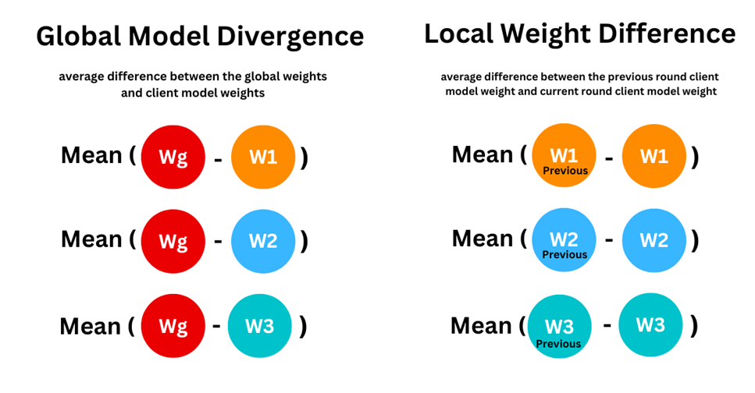
06 Metrics
Evaluation Metrics
Mean Square Error (MSE)
Structural Similarity Index (SSIM)
Root Mean Square Error (RMSE) Signal-to-Noise Ratio (SNR)
Peak Signal-to-Noise Ratio (PSNR)
Client Selection Metrics
Global Model Divergence
Local Weight Difference
Paper IPTC-23888, Federated Learning For Seismic Data Denoising: Privacy-preserving Paradigm, Kamalesh Kumar Mandakolathur Guruprasad

Slide 10
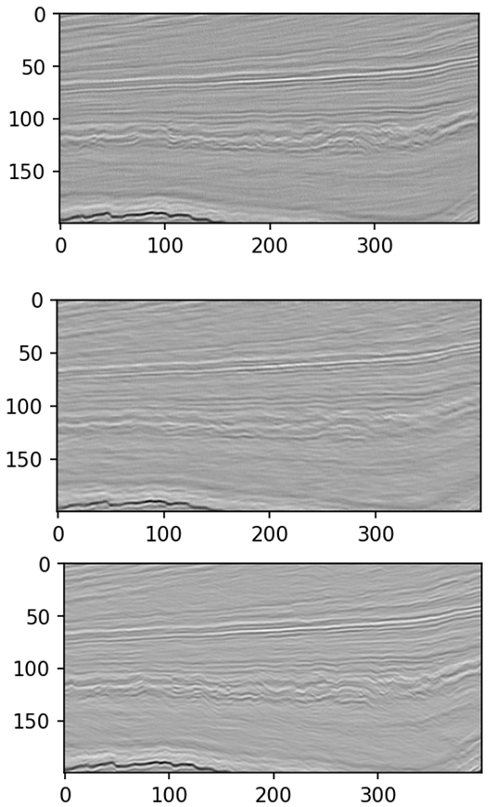
07 Results
Loss | MSE | RMSE | SNR | PSNR
0.007 | 0.007 | 0.087 | 15.707 | 24.489
Classical ML
Classical ML
Round | Loss | MSE | RMSE | SNR | PSNR
Round 1 | 0.028 | 0.028 | 0.166 | 10.056 | 18.838
Round 2 | 0.011 | 0.011 | 0.103 | 14.169 | 22.951
Round 3 | 0.008 | 0.008 | 0.091 | 15.319 | 24.101
Federated Learning
Round Based
Federated Learning - Round Based
Loss | MSE | RMSE | SNR | PSNR
0.008 | 0.008 | 0.087 | 15.680 | 24.463
Federated Learning
Cyclic
Federated Learning - Cyclic
Paper IPTC-23888, Federated Learning For Seismic Data Denoising: Privacy-preserving Paradigm, Kamalesh Kumar Mandakolathur Guruprasad

Slide 11
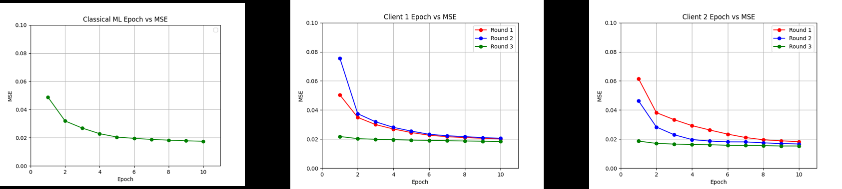
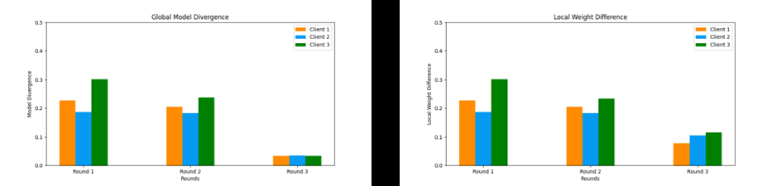
08 Inference
Classical
Federated Learning
Global Model Divergence
Local Weight Difference
Paper IPTC-23888, Federated Learning For Seismic Data Denoising: Privacy-preserving Paradigm, Kamalesh Kumar Mandakolathur Guruprasad

Slide 12
Thank You
Any Questions ?

